Slide 1

KENTMERE ACADEMY AND NURSERY
Year 3/4 Homework Menu - Autumn 1 2026
Maths & Geography
Identify the origin of the food in your cupboards and use an online atlas (or borrow a school atlas) to work out how far the item travels to reach your home.
English
Roald Dahl had his own nonsense Gobblefunk language! Research the famous nonsense poem On the Ning Nang Nong and try to write your own poem in a similar style.
History
Research the history of the cacao bean and create a timeline to show its journey through the centuries.
Science
Design an educational poster to encourage children to choose healthy snacks rather than sweets.
Homework Menu
Healthy Eating
Design and Technology
If you could invent a new
breakfast cereal, what would you use and why? Think about the name and packaging too.
Art
Create a food scape in the style of artist Carl Warner.
PSHE
Write a recipe for being a good friend, eg Take 3 teaspoons of kindness and mix it with 10g of patience...

Slide 2

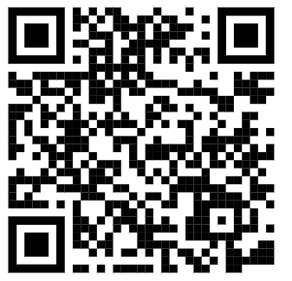


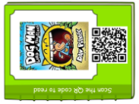
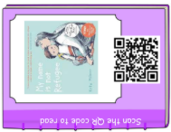
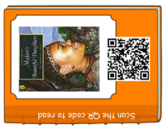
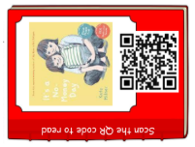
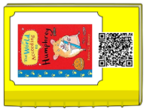
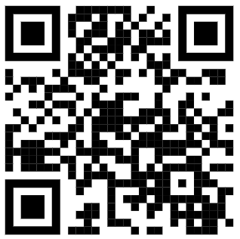
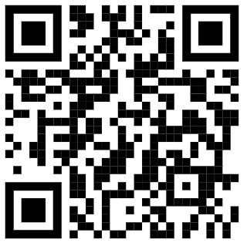
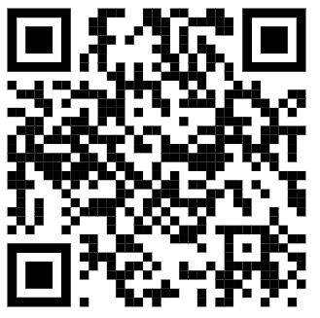
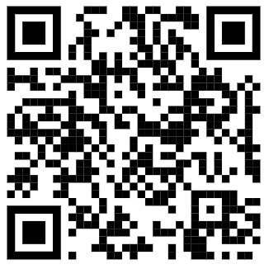
KENTMERE ACADEMY AND NURSERY
Year 3/4 Homework Menu - Autumn 1 2026
Other Useful Links
Hit the Button
Times Tables Games
Topmarks
BBC Bitesize

