Slide 1


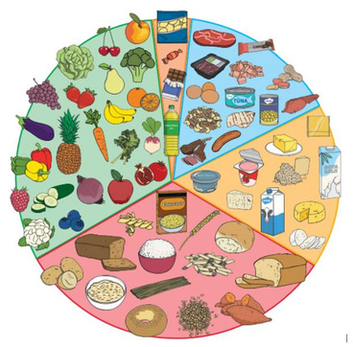
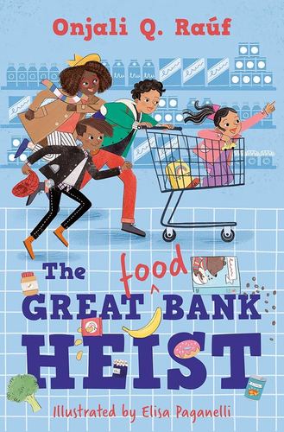

Year 3/ 4
This term we are learning about… Healthy Eating
The text we are reading this term is:
The Great Food Bank Heist by Onjali Q. Rauf
Other texts about Healthy Eating to enjoy...
Measuring up by Lily LaMatte
What’s on your plate – Exploring the world of food by Whitney Stewart Mama Panya’s pancakes by Mary and Rich Chamberlin

